Slide 1
Input Parameters
CNN Network
Dataset
ResNet18
AlexNet
CIFAR10
MNIST
TinyImageNet
STL10
Maximal allowed accuracy loss

Slide 2
Input Parameters
Max Granularity
Uniform Filters
Uniform Patch
Mode
Four different optimization modes
Uniform Layer

Slide 3
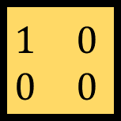
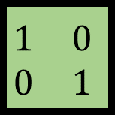
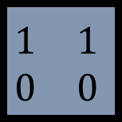
Input Parameters
Patch Size
Patterns/
Ones Range
GT
Granularity Threshold
Only in Max Granularity Mode
The spread of a single estimator block
Size of the estimator block
2x2
Possible patterns of the estimator block
$$\begin{matrix}1 & 0 \\ 0 & 1\end{matrix}$$
$$\begin{matrix}1 & 0 \\ 0 & 0\end{matrix}$$
$$\begin{matrix}1 & 1 \\ 0 & 0\end{matrix}$$

Slide 4
CNN
Optimizer
Dataset
First Level Optimization Pass
Neural Net
Start of the Optimization Algorithm Code Flow
Spatial
Layer
Spatial
Layer
Spatial
Layer
Mode
Test generator
Patch Size
Baseline calculation
Patterns/
Ones Range
Run Time Evaluation
GT

Slide 5
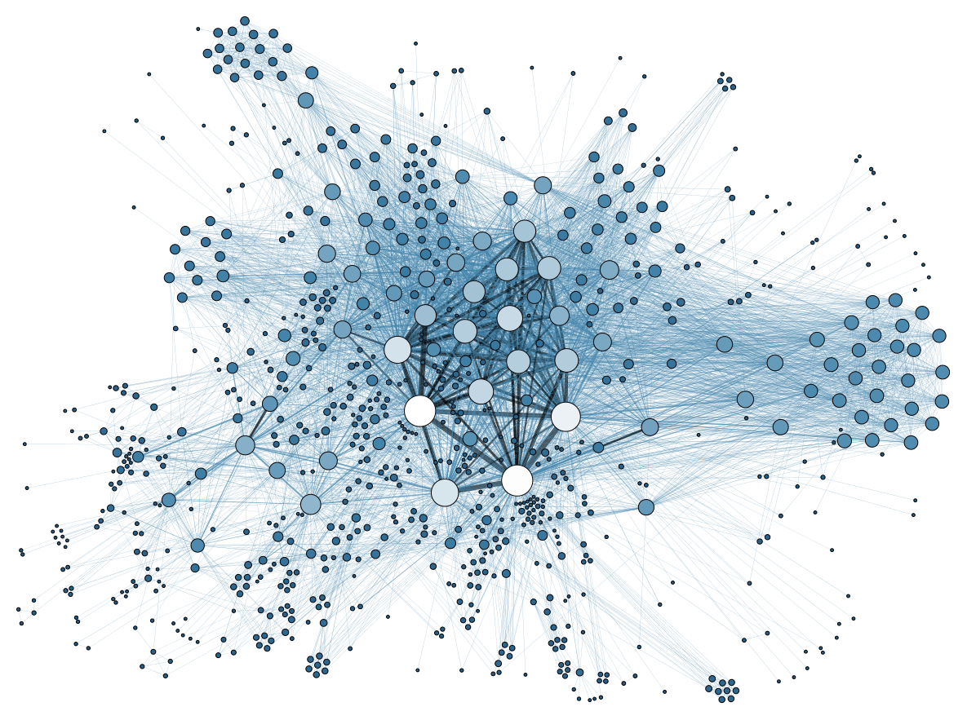
Core Presumption
No correlation assumption:
Given N patchs, optimizing jointly for all patches is equivalent to N sole optimization tasks of each.
Clearly not withheld
since ofmaps from deep layers are derived directly from ofmaps of shallower layers

Slide 6

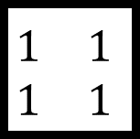
First Level Optimization Pass
$$\begin{matrix}1 & 1 \\ 1 & 1\end{matrix}$$
Default mask =
=
,
,
,
,
,
, …
,
,
, …

Slide 7
Patch Quantizer
1. Filter results and sort according to operations saved
#
1
2
3
,
#
1
2
3
, …
#
1
2
, …

Slide 8
Patch Quantizer
2. Creare channels and simulate
#
#
1
2
3
1
2
3
1
2
3
1
2
#
#
,
,

Slide 9
Channel Quantizer
Same as patch quantizer, but for creating layers
#
#
1
2
3
1
#
#
#
#
1
2
2
3
#
#
#
1
2
3
3

Slide 10
Layer Quantizer
1. Take the best option for each layer
1
1
1
2. Update layer that has the:
maximal accuracy gain
minimal ops saved drop
1
2
1
,
2
2
1
…

Slide 11
Layer Quantizer
3. When reaching the last option for each layer,
start incorporating the default layer
3
3
3
3
3
,
,
3
,
4. Find and store the configuration thet meets the maximal
allowed accuracy loss

Slide 12
CNN
FLrec
Optimizer
Patch Quantizer
Dataset
First Level Optimization Pass
Neural Net
PQrec
Spatial
Layer
Spatial
Layer
Spatial
Layer
Channel Quantizer
Mode
CQrec
Test generator
Patch Size
Run Time Evaluation
Retraining
module
Layer Quantizer
LQrec
Patterns/
Ones Range
Final mask
Baseline calculation
Final result
after retraining
GT

